Slide 1
Test Evaluerserver
By Daniel Zapata

Slide 2
“We want to satisfy our customers´ financial needs and help them succeed financially”.
Relationship between households and products? : visual analysis
Can clients being segmented?: cluster analysis

Slide 3

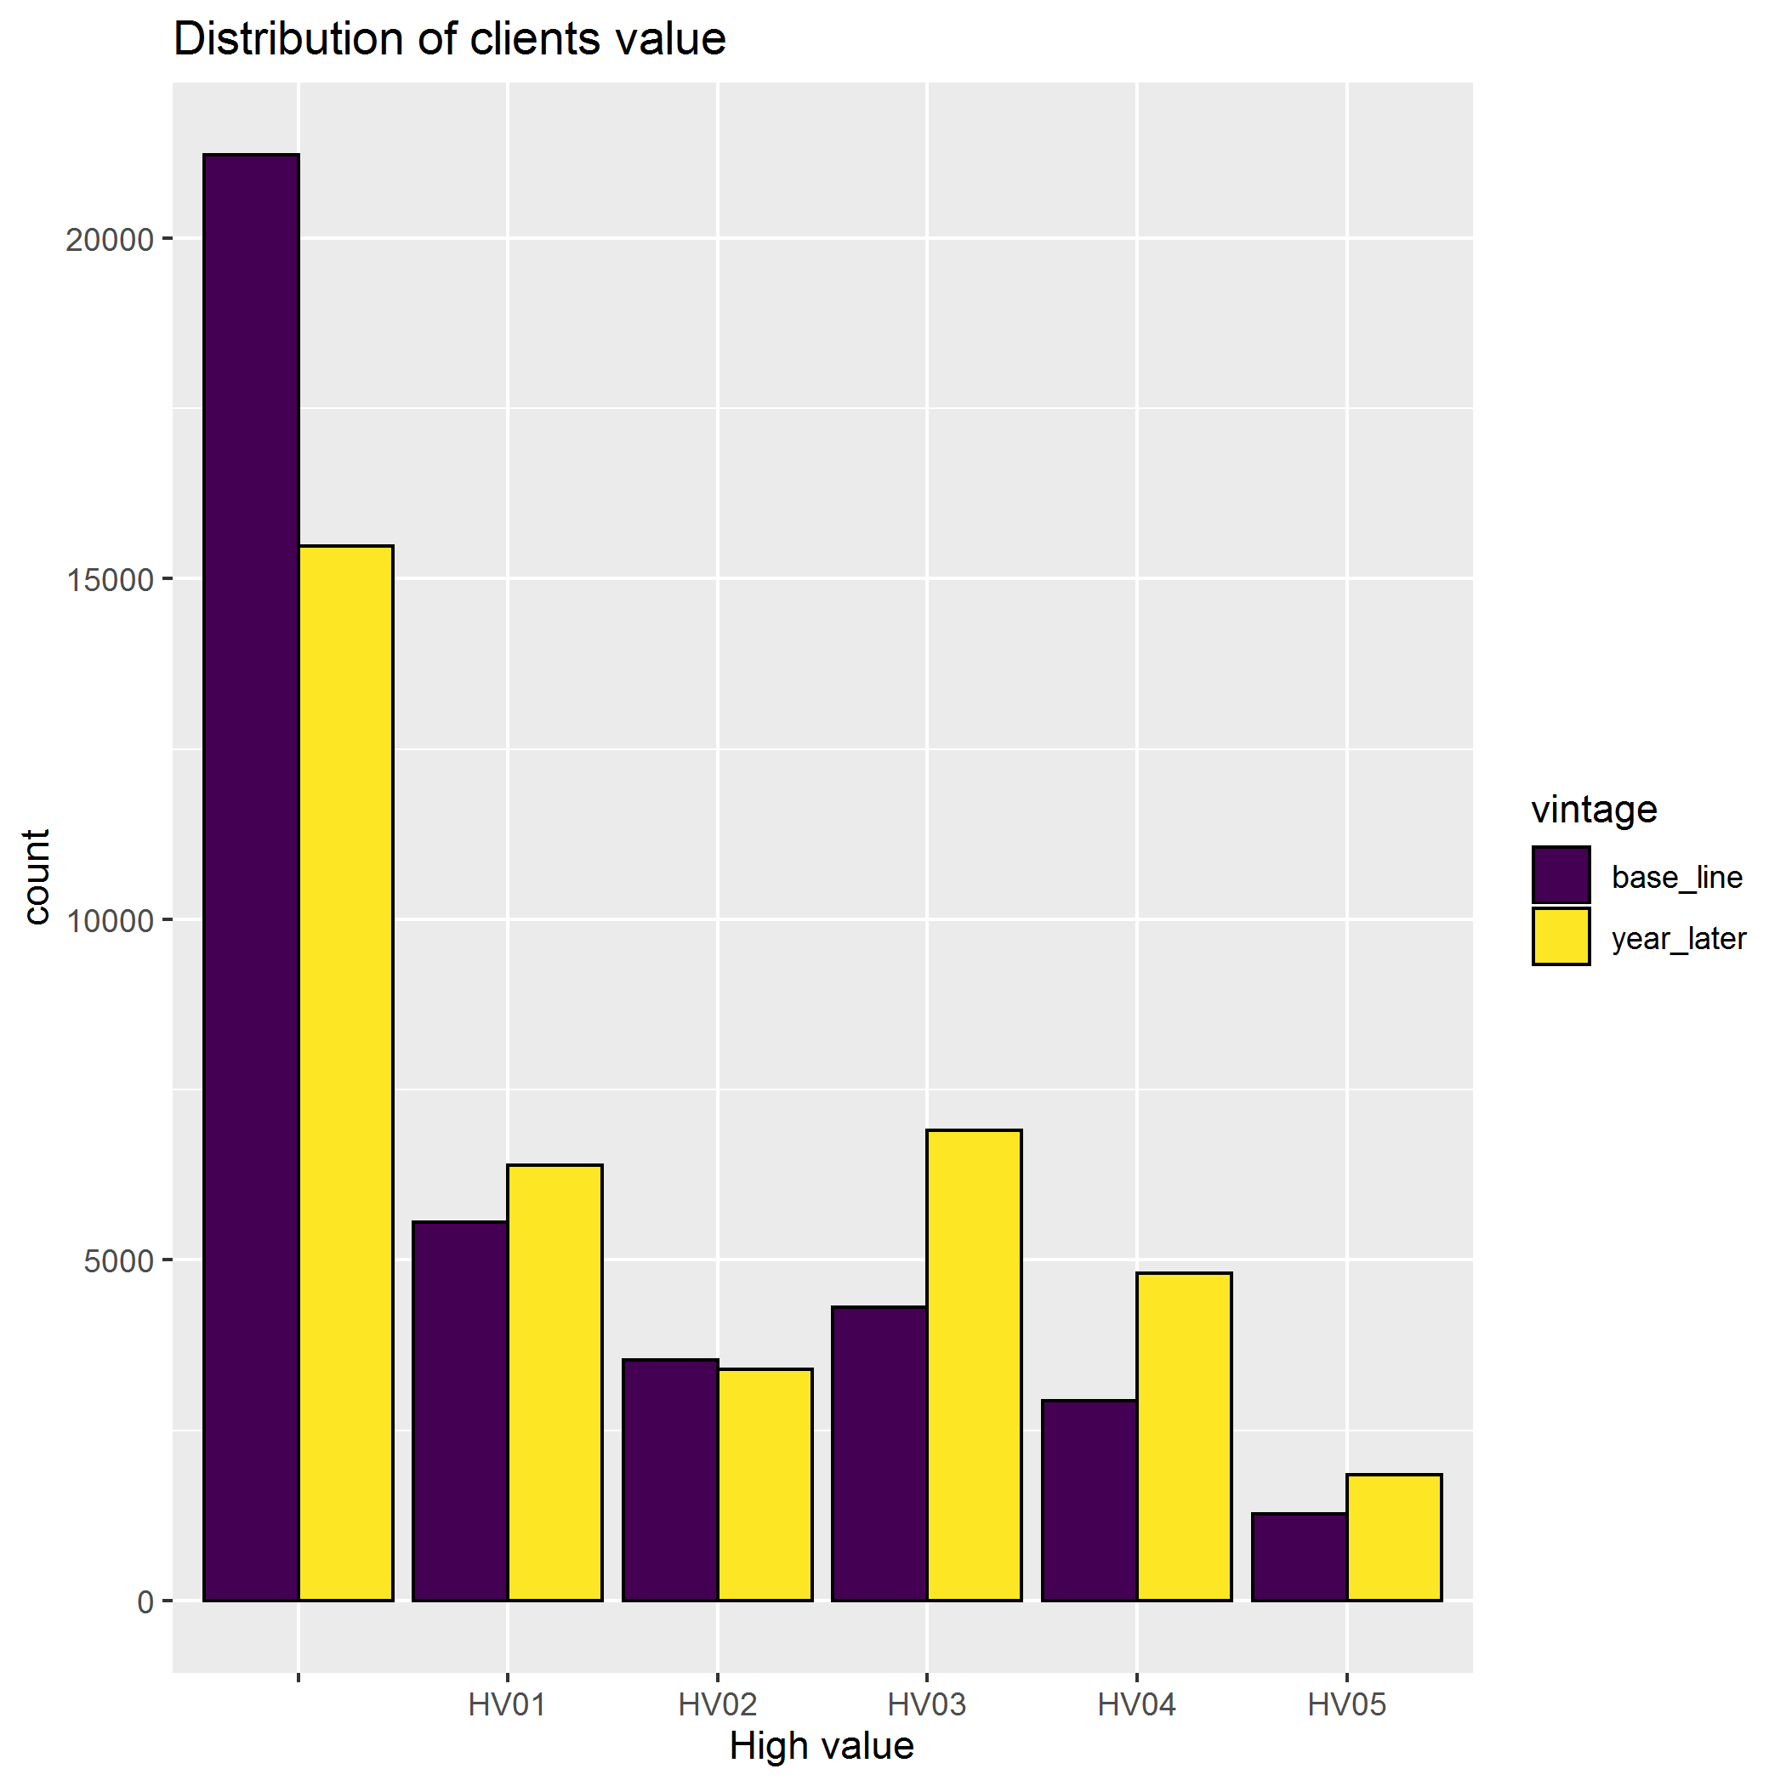
Distribution of households’ value
Some segments increased their numbers of clients
The number of clients without a value goes down

Slide 4
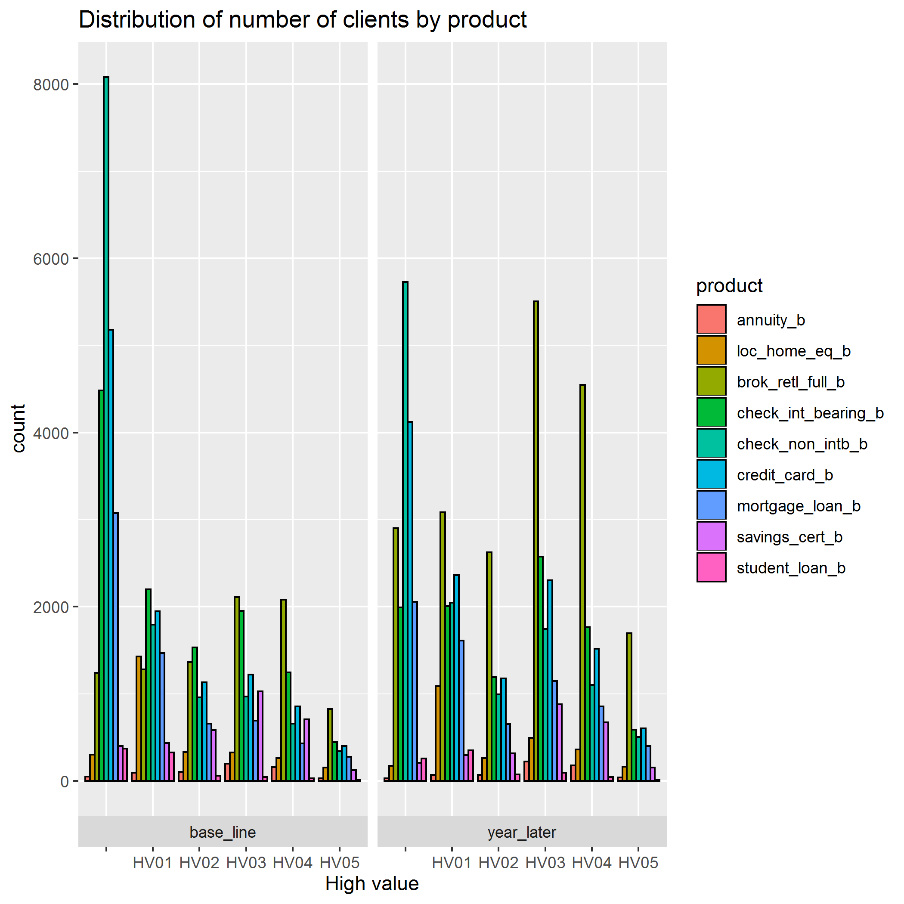
Distribution of number of clients by product
Brokerage Account increased dramatically on the last vintage. It is famous product?
Overall, product portfolio growth in size in the four first groups.
Generally, annuity, savings certificate and students loans are not so common on households portfolio

Slide 5
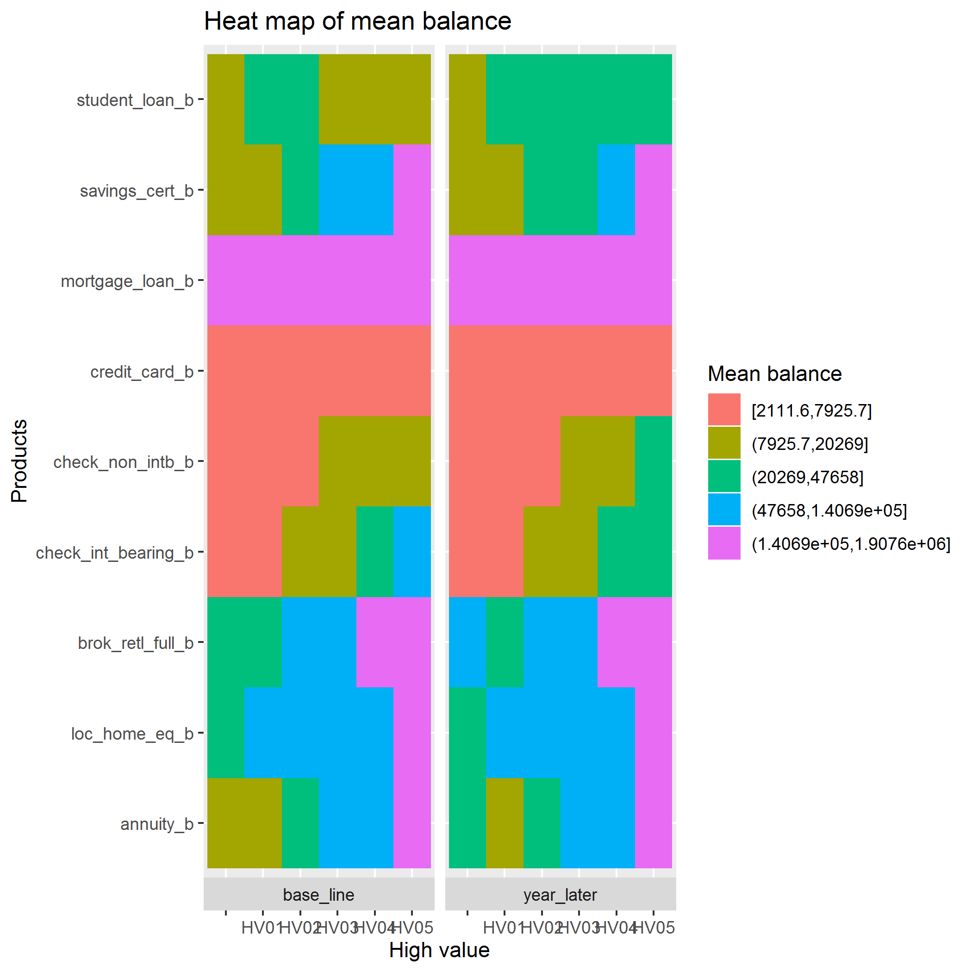
Heat map of mean balance (tetris)
Mean balance is the relation between total balance and number of clients.
Products like mortgage, credit card, Home Equity loan remain with the same mean balance in both vintages
Most of the clients decreased their balances on student loan credits

Slide 6
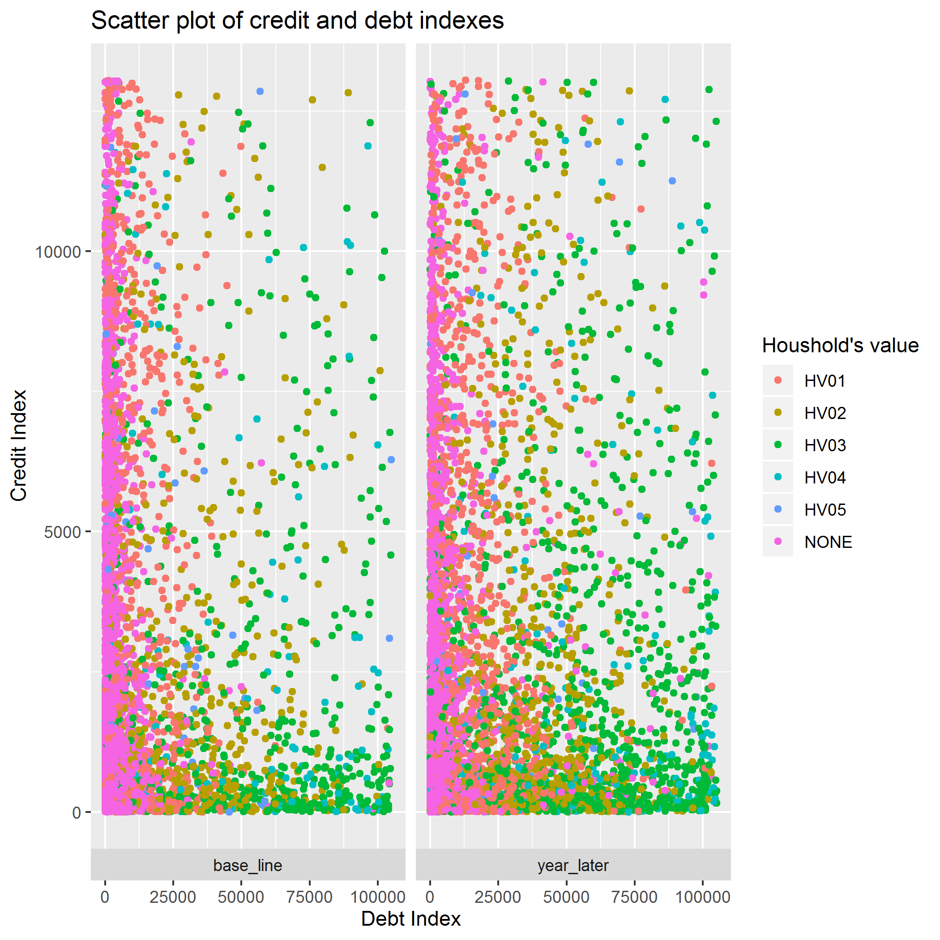
Credit and debt index
Debt and credit index is the weighted average between balances and number of products.
Good clients have a higher index in both types.
In general, there are more households from any segment with better credit and debit index value in the last vintage.

Slide 7
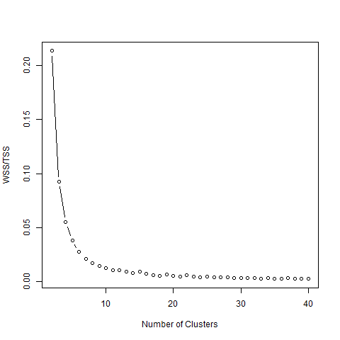
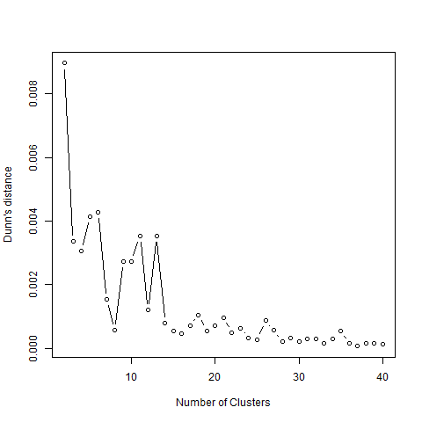
K means results
A cluster of a sample of households of the first vintage using credit and debit index.
Other variables and clusters were tried with no good results.
Six was the optimal number of cluster selected

Slide 8
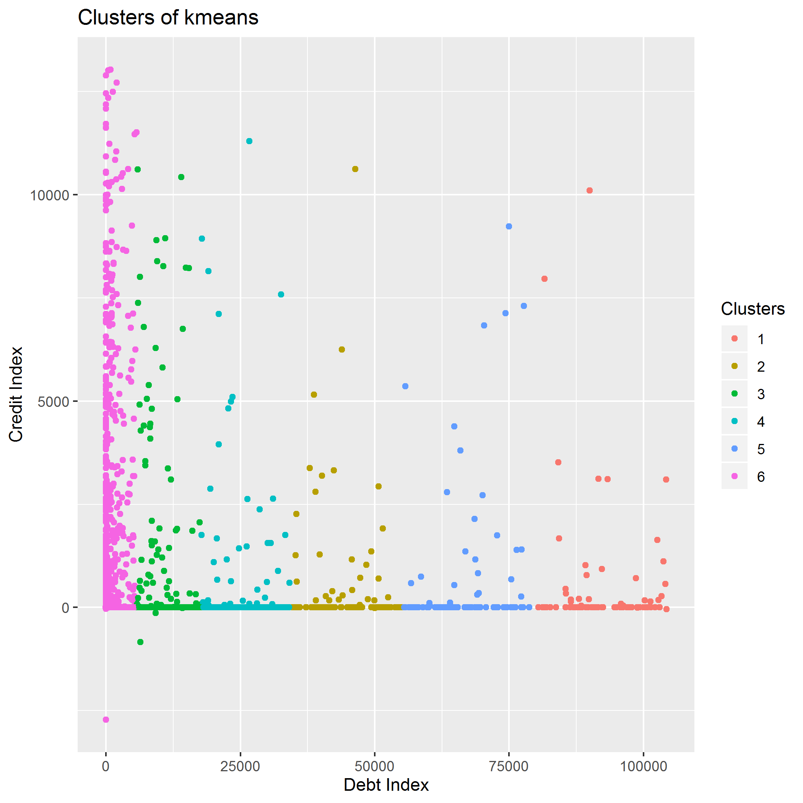
Base line vintage results
Looks like groups are not related with the original idea that higher valuable clients have a high value on both index
Credit index seems to not desegregate clients
There are a lot of clients with no debit or credit products. This is a real opportunity for cross-selling.

Slide 9
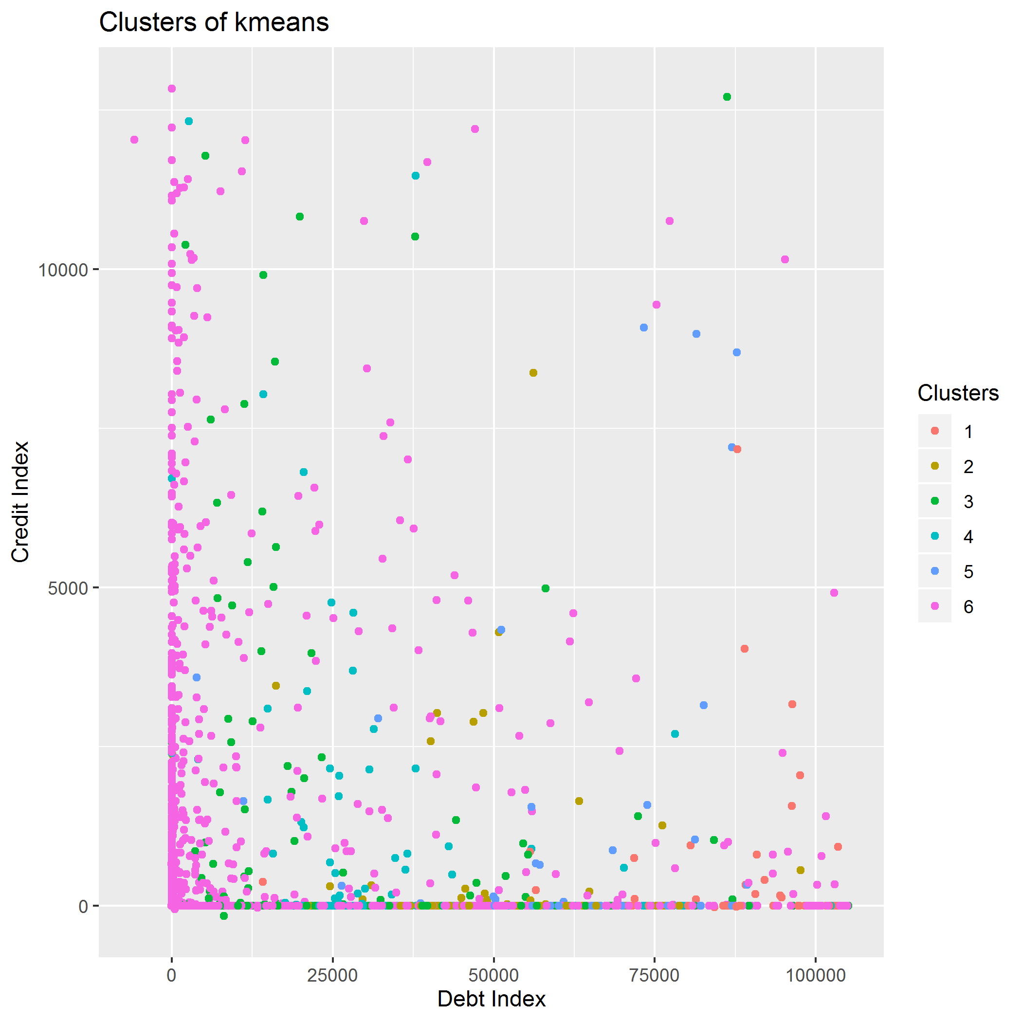
Year later vintage results
A lot of clients of the sixth cluster move northeast through the map, which makes these more valuable.
Others seems to plump dramatically their credit index and rise their debit index, why?

Slide 10
Conclusions and next steps
A cluster model could improve the current segmentation of the bank which depends only on Household-value.
If brokerage account is a strategic product, a look alike model could find households which seems to the ones that already have this product.
Including other variables as a value score of households could help to in the cluster model construction.

Slide 11
Thank you

